Slide 1
BANK MANAGEMENT SYSTEM

Slide 2
INTRODUCTION
Our project entitled “Bank Management System” Aim is One should be able to deposit money and withdraw money from a particular account as the user desires. Manual system that is employed is extremely laborious and quite inadequate. It only makes the process more difficult and harder.
The aim of our project is to develop a system that is meant to partially computerize the work performed in the bank collecting a record of deposit money , collecting a withdraw money, store record of customer.
We have described the Advantages, objective of the project. We have also provided the names of the books from which we have taken guidance to complete the work.

Slide 3
ADVANTAGES
Minimize handwritten work from Cashier to see the record of deposit-withdraw money .
It helps you to minimize your repeated works and take care of the complete functionality of deposit and withdraw departement.
It is a huge time saver and facilitates proper communication among the management, staff, and the Customers.
Provide computerized system for maintaining records.
Avoid Human storage with less computer memory.

Slide 4
Objective:-
The primary objective of the Bank Management System is to keep track of invoices, customers, deposit of money , and withdraw of money. It keeps track of all bank status related to deposit and withdraw and payments.
There should be a validation to allow only a particular amount of cash inflows at any time, as well as to allow withdraws if the balance is sufficient. There should also be the calculation of interest and its addition to the balance every month.
This program may reduce the manual processing time.

Slide 5
Proposed Of Project:
Helps in maintaining the computerized deposit and withdraw details.
Easy attendance marking.
Computerized Event Requests Management.
Calculate the deposit money and withdraw money.

Slide 6
Literature Survey:
Author Name | Year Of Publication | Observation
Md Nuruzzaman | 2021 | The date of deposit and withdraw will be refreshed while covering the bill. It keeps up the error free database and effectively joins the future turns of events and changes
Md. Jasim Uddin | 2015 | Concurrent optimization of consumer’s deposit record and withdraw money.
Author Name | Year Of Publication

Slide 7
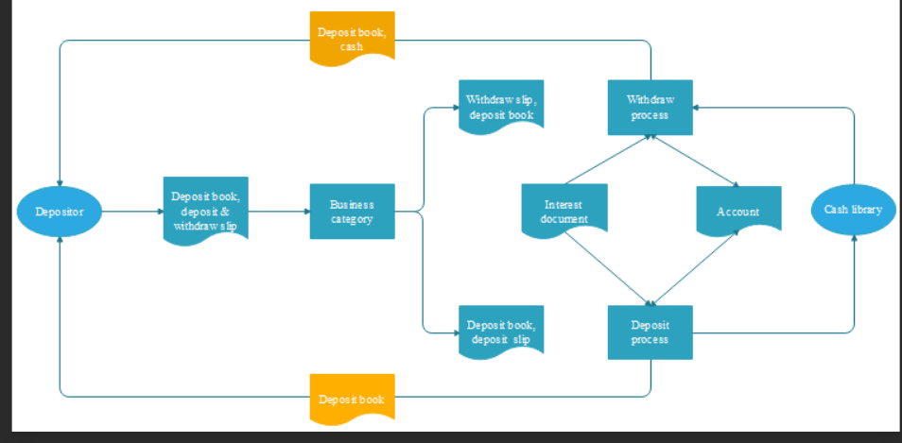
Architecture Diagram:

Slide 8
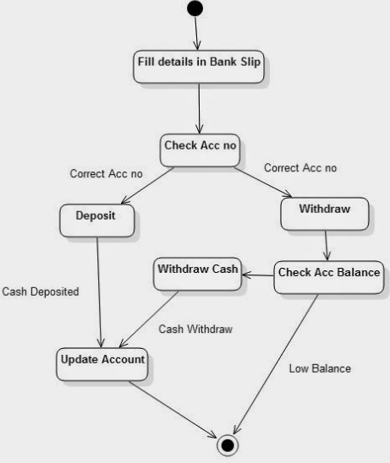
Activity diagram

Slide 9
Algorithm:
Step1:Design the use case diagram under the use case view ,sequence ,class, collaboration,activity,state chart, diagram under the logical view, component diagram under the component view. Deployment diagram under the deployment view for the online ticket reservation system. Step2: Select the menu tool in that chooses the option, in that choose the tab notation and set the default language as ANCI C++ and click ok.

Slide 10
Step3: Goto to the component view ,in that select anyone of the relevant component in the component diagram and right click the component and choose open specification and click the realize tab and assign the classes listed. Step4: Right the same component choose open specification and select general tab andset the language as and press apply. Step5: Select the same component in the browser window right click it, choose and click generate code. The directory window specifies the directory path where the header file and input files are to be stored and press ok.

Slide 11
Step6: All the required files will be generated in the specified directory. If any change is done in the class diagram does the above steps again.

Slide 12
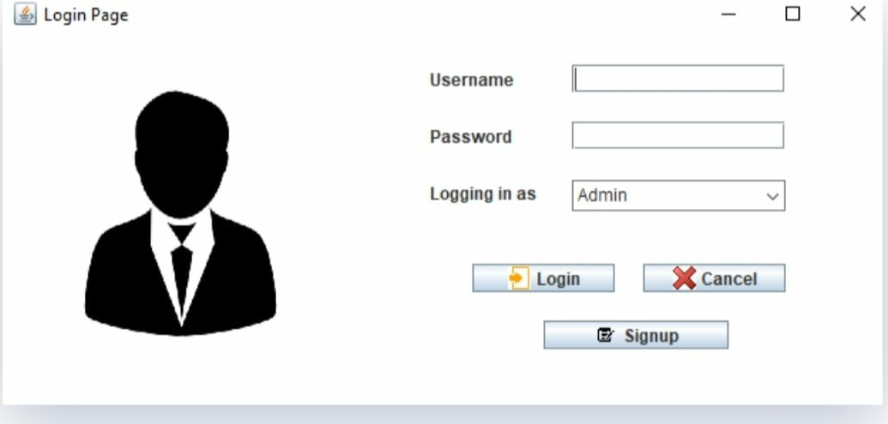
Modules:
1.LOGIN PAGE:
This page consists options of entering Username and Password using which the user can login into the existing account.

Slide 13
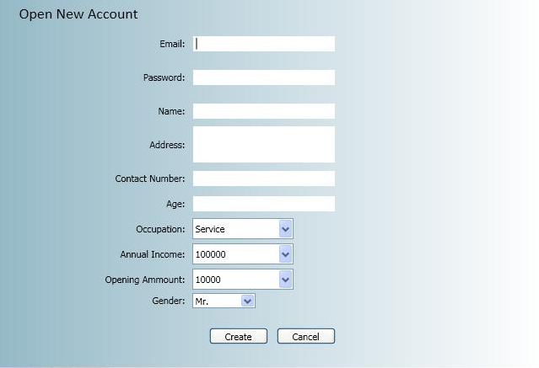
2. User Interface Details :
New Customer: If a new customer needs to be added that can be performed here by entering the required details.
Customer Details: This portrays all the customer details who have been using the application so far.
Deposit Details: Here the customer can view all his payment activity.
Withdraw Details: Here the customer can view withdraw activity.

Slide 14
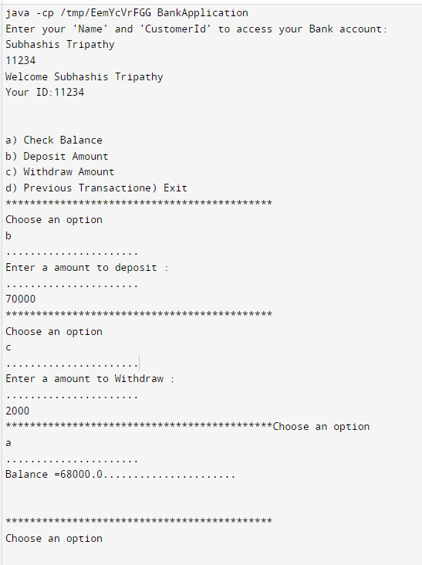
3. User Interface
Deposit : The user can deposit his bill by filling in the required data.
Withdraw:- Here the customer can withdraw money .
Check Balance:- Check the remaining balance after deposit and withdraw.

Slide 15
4. REPORT:
This provides the user the option of generating his deposit and withdraw based on the data entered in deposit and withdraw list.

Slide 16
NAME REGISTER NUMBER
Subhashis Tripathy RA2112703010020
Yerrsani Ayyapa Reddy RA2112703010030
CM Nirmal RA2112703010011

Slide 17


